Slide 1
Let’s Travel

Slide 2
Rules of Conduct
Mind your behavior
Don’t yell out your answers
Raise your hands to answer

Slide 3
In the Zoo

Slide 4
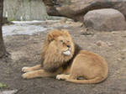
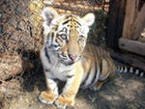
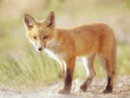

Slide 5
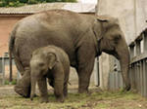
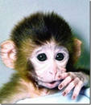
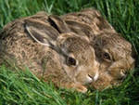
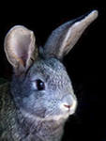

Slide 6
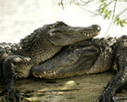
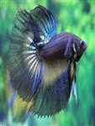
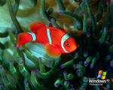

Slide 7
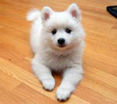
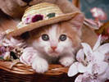
My Pet

Slide 8
Our Friendly family

Slide 9
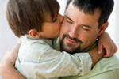
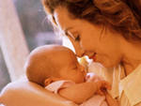
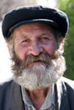
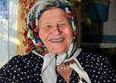
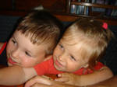

Slide 10
School station

Slide 11
Sport station

Slide 12
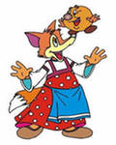
Good stories station

Slide 13
Rainbow station

Slide 14
Musical station

Slide 15
Rewarding station
Miss Know-All
Mr. Know-All

Slide 16
http://www.google.ru/search?q=%D0%BA%D0%B0%D1%80%D1%82%D0%B8%D0%BD%D0%BA%D0%B8+%D0%BF%D1%83%D1%82%D0%B5%D1%88%D0%B5%D1%81%D1%82%D0%B2%D0%B8%D1%8F&hl=ru&newwindow=1&biw=1366&bih=643&tbm=isch&prmd=imvns&ei=5SjoT8X2IcqM-wb57rCxAw&start=40&sa=N
http://www.google.ru/search?q=%D0%B4%D0%B5%D1%82%D1%81%D0%BA%D0%B8%D0%B5+%D0%BA%D0%B0%D1%80%D1%82%D0%B8%D0%BD%D0%BA%D0%B8+%D0%BF%D1%83%D1%82%D0%B5%D1%88%D0%B5%D1%81%D1%82%D0%B2%D0%B8%D1%8F&hl=ru&newwindow=1&biw=1366&bih=643&tbm=isch&ei=OS7oT5WLMY6r-Qb7kZ2xAw&start=40&sa=N
http://images.yandex.ru/yandsearch?p=1&text=%D0%B7%D0%BE%D0%BE%D0%BF%D0%B0%D1%80%D0%BA%20%D0%B6%D0%B8%D0%B2%D0%BE%D1%82%D0%BD%D1%8B%D0%B5&lr=66&noreask=1&rpt=image
http://images.yandex.ru

