Slide 1
SPECIAL QUESTIONS
Present Simple Tense
Спирина В.А.

Slide 2
К НАМ ПРИШЕЛ ДРАКОША ПРОША
ТЫ НЕ БОЙСЯ, ОН ХОРОШИЙ.
ГОЛОВЫ ЕГО И ХВОСТ
ЗАДАЮТ ЛЮБОЙ ВОПРОС.

Slide 3
ЕСЛИ ХОЧЕШЬ ТЫ СПРОСИТЬ
ИЛИ ЧТО-ТО УТОЧНИТЬ,
ПОСЛЕ
WHERE, WHAT, WHY ,WHOM
НО НЕ WHO
ТЫ ПОСТАВЬ ГЛАГОЛ TO DO
DO / DOES

Slide 4
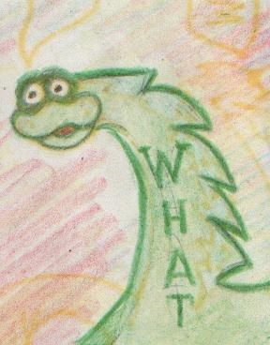
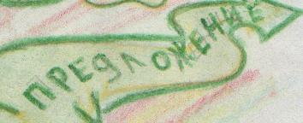
DO/DOES

Slide 5
They like to play football at the stadium every evening.
They like to play football at the stadium every evening.
What
do
they like to play ?
DO

Slide 6
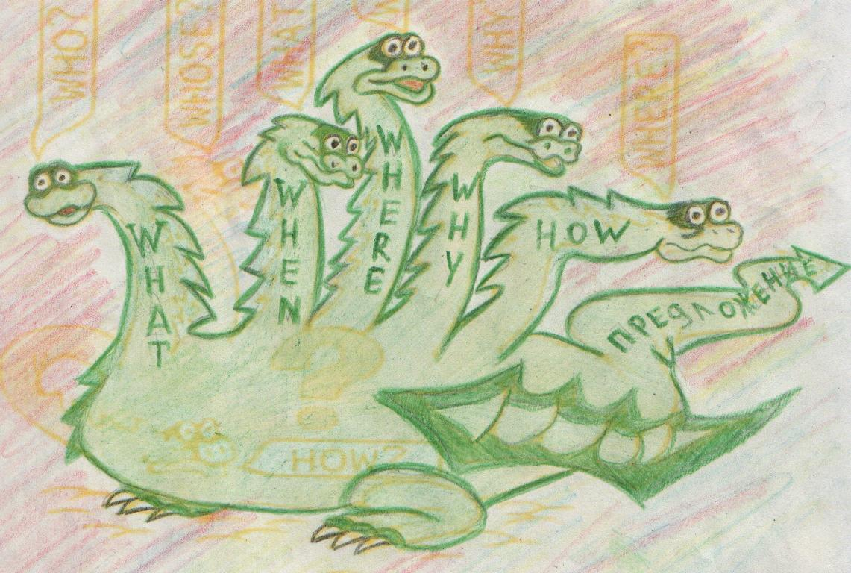
ЗАЧЕМ
ПОЧЕМУ
КОГДА
КАК
ЧТО
ГДЕ
КУДА

Slide 7
They like to play football at the stadium every evening.
WHERE
DO
They like to play football
?
They like to play football at the stadium every evening.
WHEN
DO
They like to play football at the stadium ?
WHY
DO
They like to play football at the stadium every evening ?

Slide 8
Задайте вопросы к предложениям. Дракоша Проша вам поможет.
Образец: I want to read books. 1. Do you want to read books?
2. What do you want to do?
3. What do you want to read?
4. Why do you want to read books?
We swim in the river every day.
a.
b
c.
d.
e.

Slide 9
Monkeys like to play with cats.
a.
b.
c.
d.
I usually go to school at 8 o’clock.
a.
b.
c.
d.
e.

Slide 10
Забывать никак нельзя:
Who (кто)и Whose (чей)
с Дракошей не друзья.
А теперь смотри внимательно
И запомни обязательно,
Как задать вопрос нам с Who.
Ты подумай, что к чему…
I want to read a book.
Who
want
s
to read a book
?
My sister likes to sing.
Whose
s
sister like
to sing ?

Slide 11
. Помогите Дракоше задать вопросы к предложениям.
Вставьте в пропуски глагол to do, если это необходимо. Не
забудьте о двух формах do и does.
He goes to school every morning.
Who ….. goes to school?
What …. he do every morning?
Where …. he go every morning?
Why …. he go to school every morning?
My friends swim in the lake in summer.
Who … swims in the lake in summer?
Whose friends …. swim in the lake in summer?
When …. my friends swim in the lake in summer?
What … my friends do in summer?

Slide 12
What … he like to do in the evening?
Who …. wants to be a doctor?
Where …. your brother live?
When … you usually go to the stadium?
Whose sister … wants to be a teacher?
What … she do at the Zoo?
Where … you live?
Where … he usually play tennis?

Slide 13
Задайте вопросы к подчеркнутым словам.
Образец: Mike plays football well. A. Who plays football well?
B. How does Mike play football?
1. They always get up at 8 o’clock.
I have got a big house in the country.
She comes home at 5 o’clock.
Our granny is a driver.
Tom and Mike come home early.
My father usually eats eggs for breakfast.
My sister is a pupil.
Linda has got a new pen in her pencil-box.
I want to buy this book.
My friend wants to be a doctor.

Slide 14
Какие из голов Дракоши Проши могут задать эти вопросы?
…. do you live?
…. is your best friend?
…. do they get up in the morning?
…. are you angry?
…. does your mother work?
…. do you draw?
…. helps you with your homework?
….. cat is it?
…. does he go every evening?
…. is your name?

Slide 15
Задайте вопросы, на которые могли бы быть даны эти
ответы.
? - My name is Kate.
? - I live in Russia.
? - Yes, it is. My family is big.
? - My mother works in a shop.
? - My father works in a bank.
? - Yes, I do. My school is very big.
? - My best friend is Alice.
? - I like to dance and to sing.
? - Yes, I do. I like music very much.
? - Yes, I have. They are a cat and a dog. I love them.

Slide 16
МОЛОДЦЫ

Slide 17
Источники:
Каркусова Д.М «English Grammar Land»
Издательство «Каро»
2003

