Slide 1
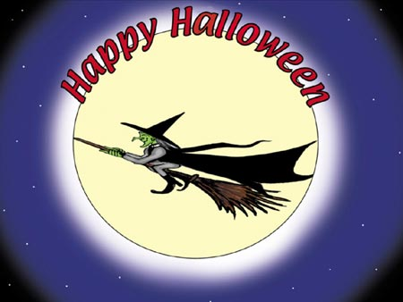

Slide 2
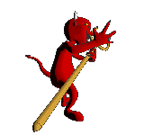
The history of festival.
The pagans who lived in Britain two thousand years ago celebrated their New Year on 1 November. Then the Christians came and people celebrated Hallowmas, a three-day festival between 31 October and 2 November. 31 October was called All Hollow’s Eve, and slowly the name changed to Halloween.
In November, winter is near, and hundreds of years ago people believed that bad spirits, like ghosts, came in the winter. They wanted the bad spirits to go away, so they made fires outside and used big autumn fruit or vegetables to make jack o’lanterns.

Slide 3
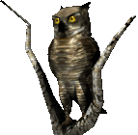
A ‘jack o’lantern’
The name ‘jack o’lantern’ means ‘Jack of the lantern’. A lantern is a kind of light, and some people think jack was a nightwatchman who had one of these lights.
To make a jack o’lantern, people cut a hole in a large fruit-usually a pumpkin. Then they put a candle in the hole, and cut a face in the side so the light was easy to see.
Another thing people did, to make the bad spirits go away, was to dress like witches and ghosts.

Slide 4
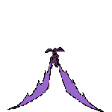
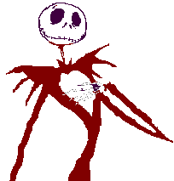
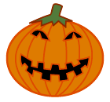
Halloween parties
Children still do this if they go to Halloween parties. People often put up decorations are usually black and orange. One Halloween party game is called ‘bobbing for apples’. Many apples fall off the trees in October so they are easy to find.
Someone puts water and apples in a big bowl. The apples stay on top of the water. Often someone puts something round the first player’s head so they cannot see. The player must keep their hands behind their back and take an apple out of the water with their teeth. Then the next player tries. The game is sometimes very difficult and players usually get very wet!

Slide 5
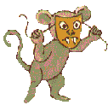
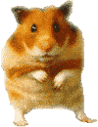
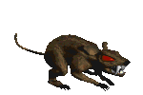
‘Trick or treat?’
In Canada and the USA, and sometimes in Britain, children go ‘trick or treating’. They dress like witches and ghosts, and go to the houses around where they live, often in a small group. When someone answers the door, the children say: ‘Trick or treat?’ This means that the person in the house must decide. Either they give the children a treat or the children will play a trick on them. For a trick the children sometimes throw something like an egg at the house.

Slide 6
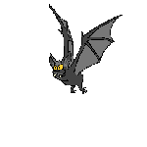
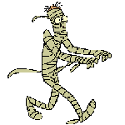
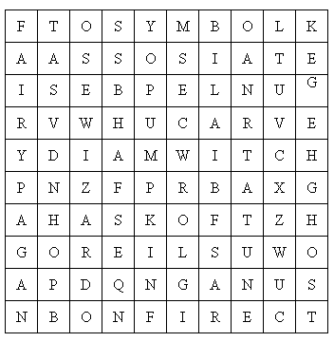
Scanwords

